Slide 1
Multiple Linear Regression (Backward EliminatioN) The selling price of houses
Kevin (M08158054)

Slide 2
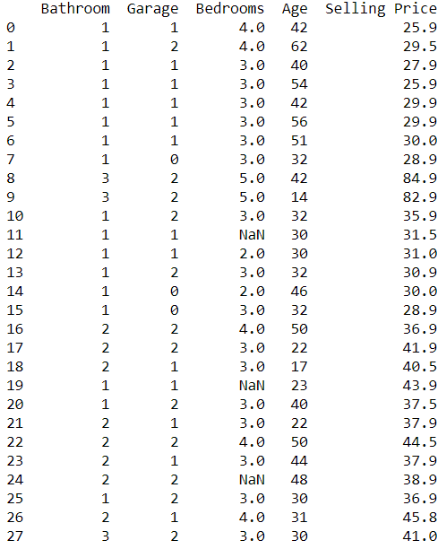
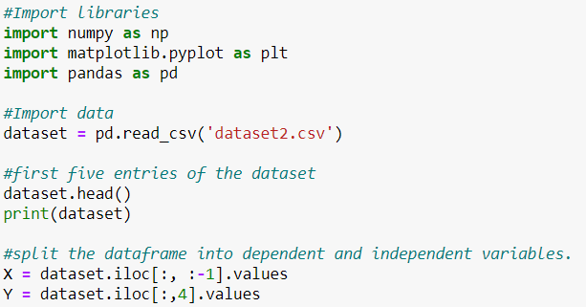
Import The Dataset

Slide 3
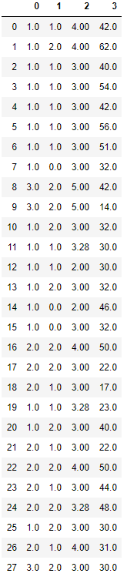
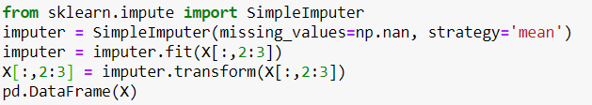
Fill missing values

Slide 4
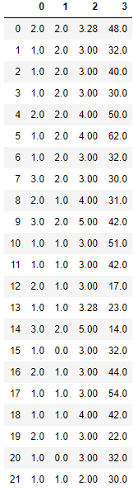

Splitting Dataset

Slide 5

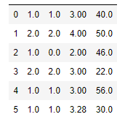


Slide 6
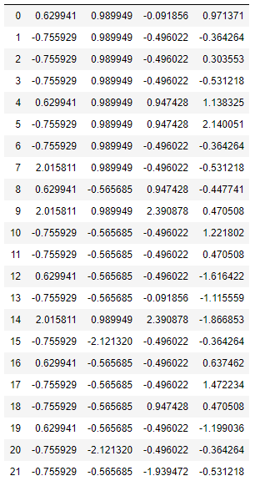
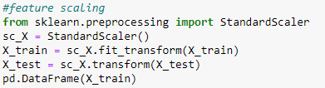
Feature Scaling

Slide 7
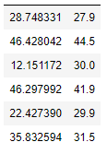

Slide 8
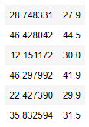
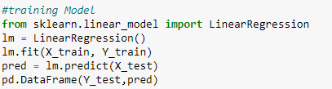
Training Model

Slide 9
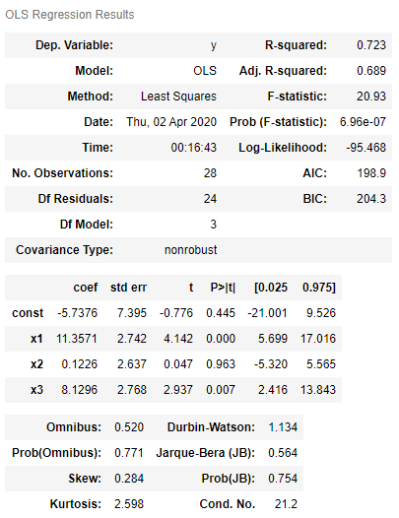
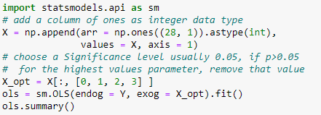
Backward elimination
= highest value

Slide 10
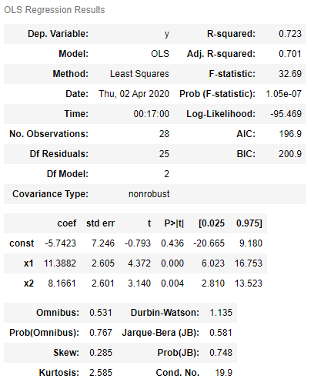

first elimination

Slide 11
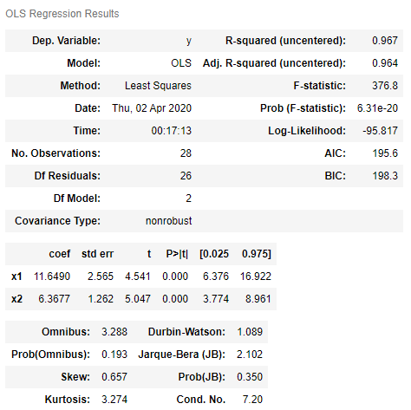

Second elimination

Slide 12
conclusion
We got our optimal model with using backward elimination. The optimal team of independent variables that can predict a selling price with the highest statistical significance is actually composed of two independent variables
Number of The Garage (X1)
Age of The House (X3)

Slide 13
Thank you

